Slide 1
Internet and Web Technology ICT- 2205 Lecture - 4
Presented By:
Mehrin Anannya
Lecturer
Institute of Information Technology
Jahangirnagar University.

Slide 2
Contents
Web
Evolution of Web
History of WWW
Web Terminologies
Web Page

Slide 3
Web
The Web is a set of technologies that allow information on the Internet to be linked together through the use of links, or connections, in documents.
The language used to write these documents with links is HTML. first introduced by Ted Nelson.

Slide 4
Evolution of Web
Web 1.0 (1991–2003)
Web 2.0 (2004–Till date)
Web 3.0 (2006–Till date)

Slide 5
Web 1.0 (1991–2003)
The first generation of the Web, Web 1.0, was introduced by Sir Tim Berners-Lee in late 1990s.
Information-oriented Web.
It is Read-only Web.
Connects real people to the World Wide Web.
A Web of cognition.
Shopping carts.
Static Web.
The core elements were HTTP, HTML, and URL.
Web Search Engines

Slide 6
Web 2.0 (2004–Till date)
The term Web 2.0 is primarily linked with web apps that assist interactive information sharing, collaboration, user-centered design, and interoperability on the World Wide Web.
It is Social Web.
connects real people who use the World Wide Web.
It is a Read-Write Web.
A Web of communication.
Blog, Social Media, and Video-streaming.
XML/Rich Site Summary(RSS)

Slide 7
Web 3.0 (2006–Till date)
It refers to the latest version of the Web.
Semantic Web.
The Personal Portable Web.
The Read-Write-Execute Web.
Intelligent Web, where software agents will collate and integrate information to give “intelligent” responses to human operators.
A Web of co-operation.
Resource Description Framework (RDF)/ Resource Description Framework Schema (RDFS)/OWL.

Slide 8
History of WWW
The development of what eventually became the World Wide Web was introduced in the 1989 by Tim Berners-Lee and others at CERN in Geneva, Switzerland.
The idea was to use the notion of hypertext so that scientific documents could be made available over the Internet to anyone who had a connected computer.
HTML was developed for the purpose of describing the structure of documents containing such links that would be made available, and “browsers” with simple text-based interfaces were used to retrieve and display these documents.
It was not until Mosaic, the first widely used browser with a Graphical User Interface (GUI), was developed that the World Wide Web really took off.
The rest, as everyone now knows, is history.

Slide 9

The inventor of WWW
Sir Tim Berners-Lee

Slide 10
Web Terminologies
Web Page
Web Page versus Web Site
Web Site versus Web application
Web App versus Web Service
Server

Slide 11
Web Page
A web page is a document that can be displayed in a web browser.
Web pages can be either static or dynamic.
Static means the page is constant or unchanging, while dynamic means the page changes.
Therefore, static web pages contain the same pre-built content each time the page is loaded, while the content of dynamic web pages can be generated on the fly.

Slide 12
Static web page:
Static means the page is constant or unchanging.
Static web pages contain the same pre-built content each time the page is loaded.
Standard HTML pages are static web pages.
They contain HTML code, which defines the structure and content of the web page.
Each time an HTML page is loaded, it looks the same.
The only way the content of an HTML page will change is if a web developer edits and publishes an updated file.

Slide 13
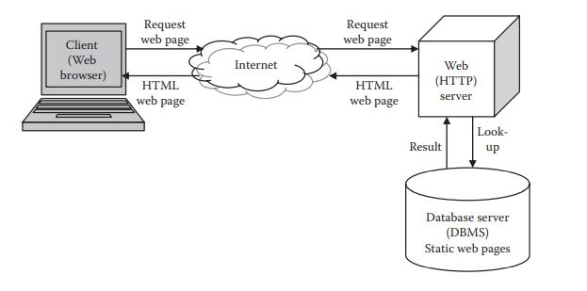
Static web page(cont.):

Slide 14
Dynamic web page:
Dynamic means the page changes. The content of dynamic web pages is generated on the fly.
It contains server-side code—such as PHP, ASP (Active Server Pages), or JSP (Java Server Pages)—that allows the server to generate unique content each time the page is loaded.
A dynamic page displays different content for different users while retaining the same layout and design.
Many dynamic pages use server-side code to access database information, which enables the web page content to be generated from information stored in a database.
The dynamic page request is addressed by a two-level response system that includes a web server and an application server.
For example, the server might display the current time and date on the web page. It might also output a unique response based on a web form the user completed.

Slide 15
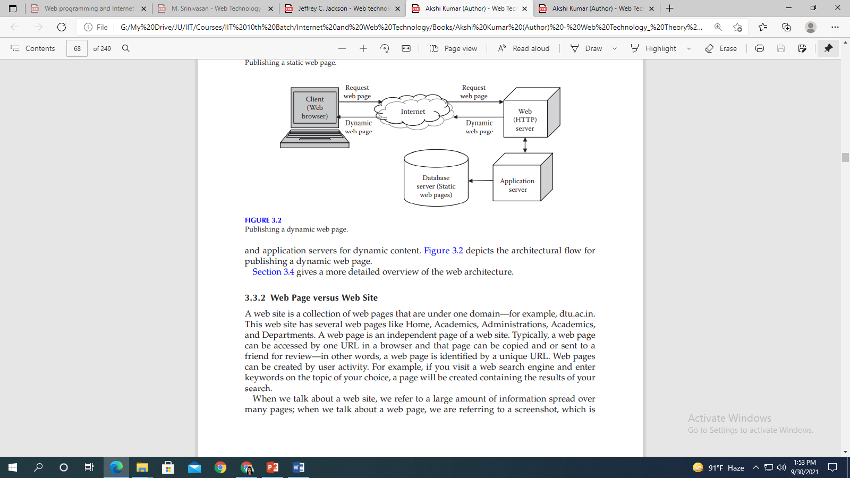
Web Page(cont.)
Dynamic web page(cont.):

Slide 16
Two Types of Dynamic Web Pages
Client-side Scripting: A web page that changes in response to an action within it (“client-side event”) uses client-side scripting. These scripts generate “client-side content” on the user’s computer, rather than the webserver.
Server-side Scripting: A web page that changes when it’s loaded or visited, or based on what’s submitted to it, uses server-side scripting. When the pages are loaded, server-side content is generated. Examples include login pages, shopping carts and submission forms.

Slide 17
How are Dynamic Web Pages Processed?
When the webserver receives a user request for a dynamic page, it does not send the page directly to the requesting browser as it would do with a static page.
Instead, it passes the page to the application server which then completes three activities:
Read the code on the page
Finish the page according to the code’s instructions
Remove the code from the page
This results in a static page that’s passed back to the web server by the application server, and then to the requesting browser for display.
The application server cannot communicate directly with the database, so it requires a database driver that functions as an interpreter and lets the application read and manipulate data that would otherwise be indecipherable.

Slide 18
Single Page Application(SPA):
It is a single page (hence the name) where a lot of information stays the same and only a few pieces need to be updated at a time.
For example, when you browse through your email you’ll notice that not much changes during navigation - the sidebar and header remain untouched as you go through your inbox.
The SPA only sends what you need with each click, and your browser renders that information.
This is different to a traditional page load where the server re-renders a full page with every click you make and sends it to your browser.
This piece by piece, client side method makes load time must faster for users and makes the amount of information a server has to send a lot less and a lot more cost efficient.

Slide 19
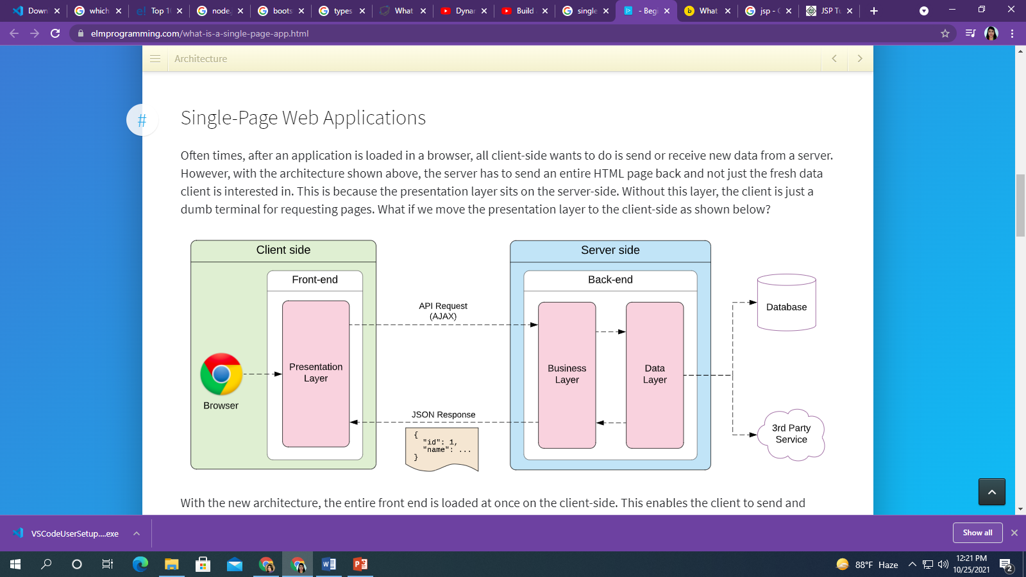
Web Page(cont.)
Single Page Application(SPA):

